Slide 1

Transportation Management Plans
Duane Thomas, P.E.
August 14, 2019

Slide 2
TMP Workshop Outline
Module 1: Work Zone Safety and Mobility Issues
Module 2: Overview of Subpart J
Module 3: TMP BASICS
Module 4: Impact Assessment and Mitigation
Module 5: Public Information Plans
Module 6: TMP Monitoring and Evaluation
Module 7: TMP Resources and Wrap-up

Slide 3
Module 1
Work Zone Safety and Mobility Issues

Slide 4
Work Zone Safety and Mobility Issues
Why we should care about work zones
Extent of work zones
Potential negative consequences of work zones
General work zone mitigation strategies

Slide 5
Why We Should Care About Work Zones?
Potential economic disruption
Impair quality of life
Potential to jeopardize safety
Problem is not temporary
New reality: System management & operations
Growth in capital expenditures

Slide 6
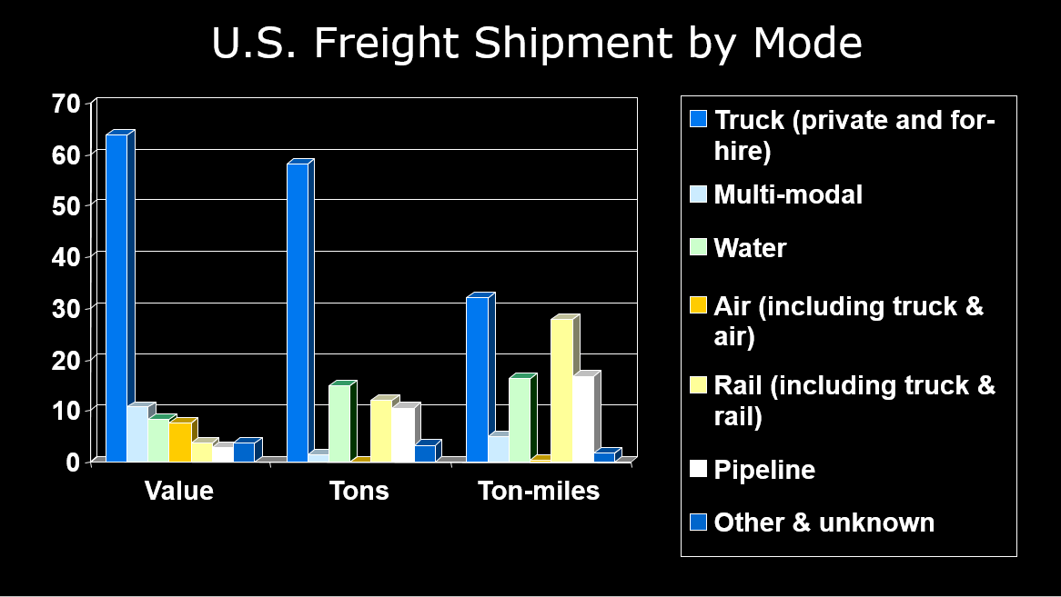
Why We Should Care About Work Zones?

Slide 7
Work Zones: Scope and Scale
Exposure: Part of the Driving Experience
Over 11 billion VMT through construction
One active WZ encountered per 100 miles driven on the NHS, representing over 12 billion hours of vehicle exposure nationally; half involve lane closures

Slide 8
Negative Consequences of Work Zones
Responsible for:
  24% of non-recurring freeway delay
  10% of all congestion
2nd leading cause of public dissatisfaction with transportation (behind poor traffic flow)

Slide 9
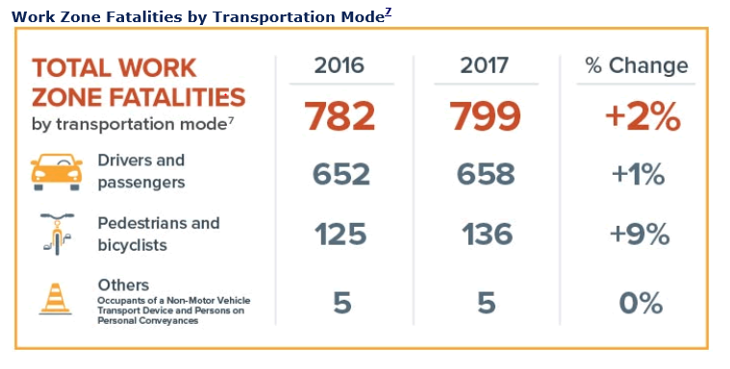
Negative Consequences of Work Zones
Source: Fatality Analysis Reporting System (FARS) 2016 Final and 2017 Annual Report File, National Highway Traffic Safety Administration (NHTSA).

Slide 10
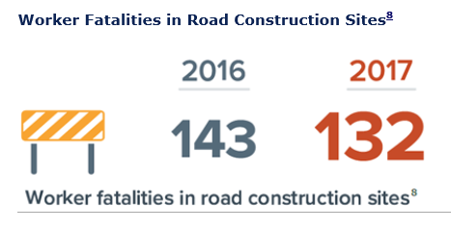
Negative Consequences of Work Zones
8 times higher than the rate of all workers
2 times the rate of other construction workers
Source: 2016 and 2017 U.S. Department of Labor, Bureau of Labor Statistics

Slide 11
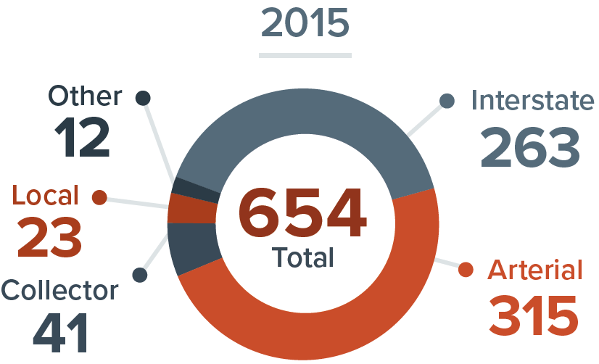
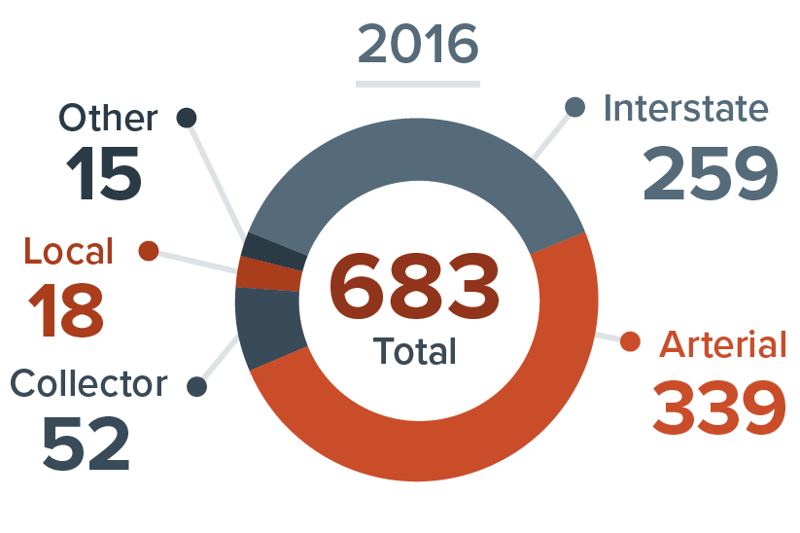
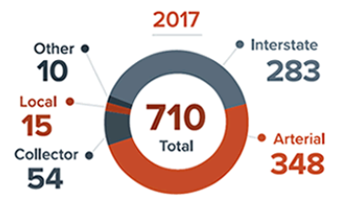
Negative Consequences of Work Zones
Source: Fatality Analysis Reporting System (FARS) 2015 and 2016 Final and 2017 Annual Report File, National Highway Traffic Safety Administration (NHTSA).

Slide 12
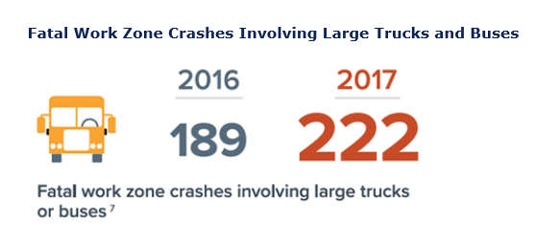
Negative Consequences of Work Zones
Source: Fatality Analysis Reporting System (FARS) 2016 Final and 2017 Annual Report File, National Highway Traffic Safety Administration (NHTSA).

Slide 13
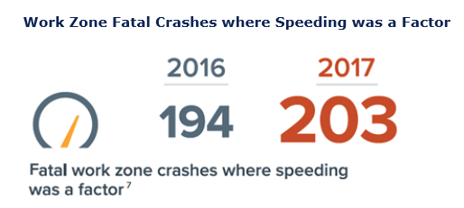
Negative Consequences of Work Zones
Source: Fatality Analysis Reporting System (FARS) 2016 Final and 2017 Annual Report File, National Highway Traffic Safety Administration (NHTSA).

Slide 14
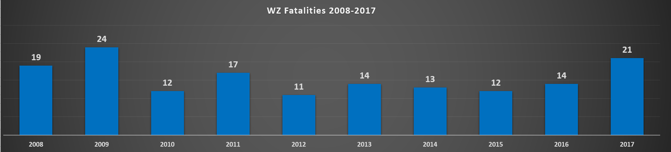
Negative Consequences of Work Zones
Arkansas WZ Fatalities
Ranked 10th in the US for 2017
Source: Fatality Analysis Reporting System (FARS), National Highway Traffic Safety Administration (NHTSA).

Slide 15
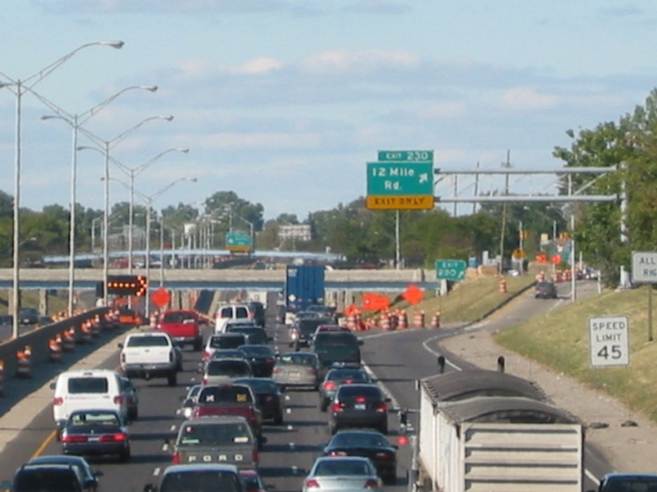
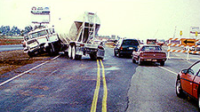
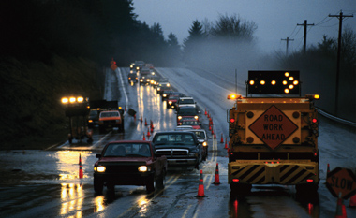
Can we do better?

Slide 16
Improvement Strategies
Systematic Improvements
Improve driver performance
Reduce work zone risk factors
Reduce mobility impacts
Reduce exposure

Slide 17
Systematic Improvements
Develop/implement policies
  Integrate policies into business process procedures (SMS, design, etc)
  Monitor performance
  Collect & analyze data; make improvements
Improve human capital
Forge effective partnership

Slide 18
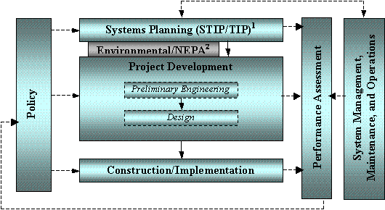
Integrate Work Zone Policies into Procedures

Slide 19
Systematic Improvements
Improve Work Force knowledge
  Development
  Design
  Implementation
  Operation
  Inspection
  Enforcement
Training geared toward improved decisions

Slide 20
Systematic Improvements
Forge Effective Partnerships
Advocacy groups
Business/merchants
Cities/local govt.
Emergency response agencies
Legislative/political offices
Media
Major employers
Neighborhood associations
Transit agencies
Transportation management associations
Utilities

Slide 21
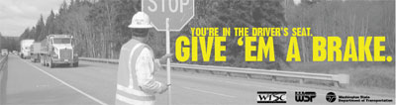
Improve Driver Performance: Driver Education
Campaigns and Slogans
  “Give em’ a Brake”
  “Slow Down, My Daddy Works Here”
  Newspaper, Radio, Television, PSAs

Slide 22

Improve Driver Performance: Driver Education
Work Zone Awareness Week
Raise awareness
Provide drivers tips for driving
safely through work zones
Recognize those who have
died in work zones

Slide 23
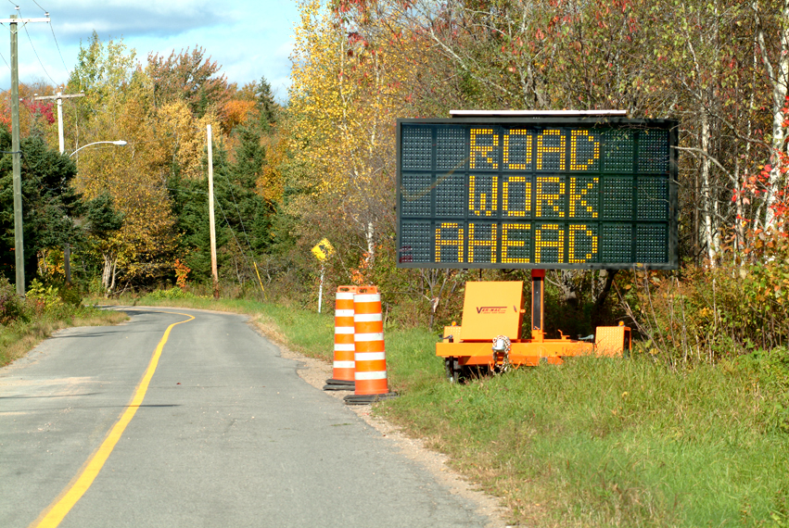
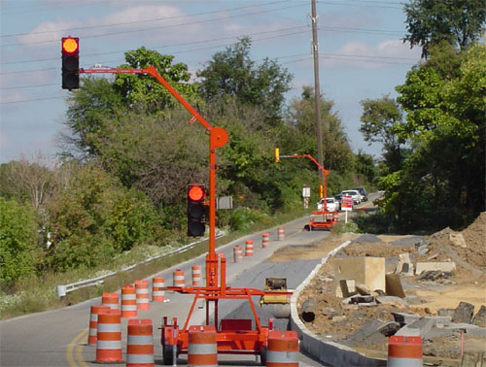
Improve Driver Performance: Compliance
Display TTC devices visibly
Improve credibility of signs
Enforcement of traffic laws in work zones
Increased penalties in work zones

Slide 24
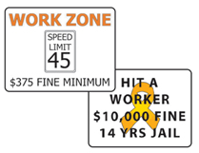
Improve Driver Performance: Compliance
Example of Increased Fines

Slide 25
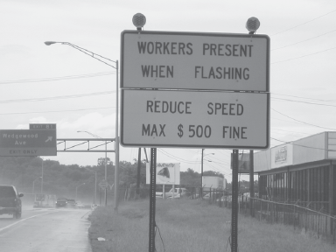
Improve Driver Performance: Compliance
Enforcement
Officers on general patrol
Officers dedicated/assigned to project
Automated speed enforcement

Slide 26
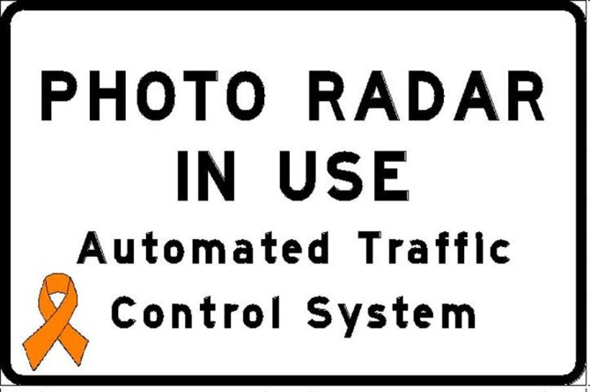
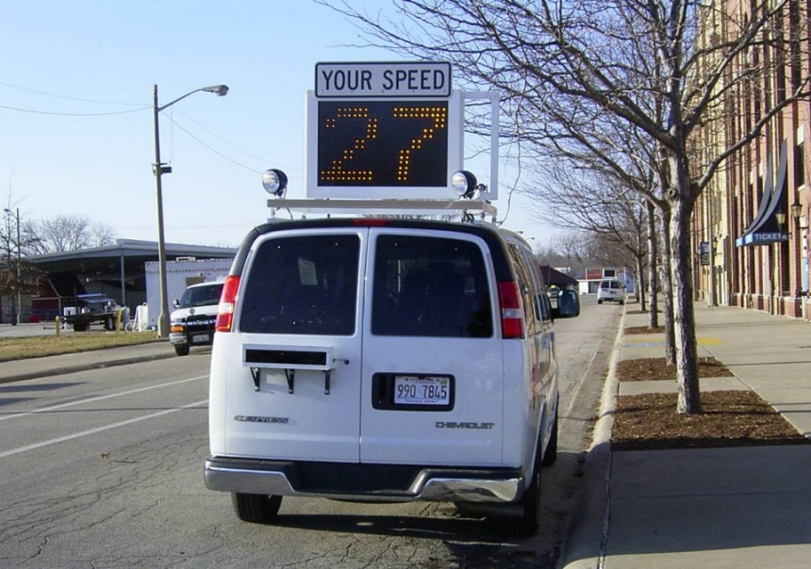
Improve Driver Performance: Compliance
Example: Illinois Photo Speed Enforcement
Workers present
Work zone is signed
No time of day restrictions
Work zone fine structure applies

Slide 27
Reduce Work Zone Risk Factors
Confusing Information Sources
Distractions
Roadside Hazards
Lack of Positive Guidance
Queues
Conflicts (construction, pedestrians, access)
Inattentive Driving
Aggressive Driving

Slide 28
Reduce Mobility Impacts
Manage demand (major projects)
Maintain and augment capacity

Slide 29
Reduce Work Zone Exposure
Reduce duration
Reduce number
Reduce traffic volumes
Get In; Get Out; Stay Out!

Slide 30
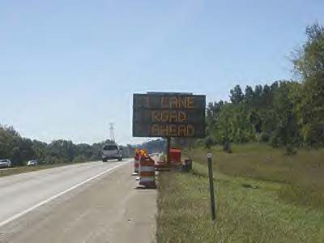

Work Zone Safety and Mobility Issues
Safety First
Alert, Inform, and protect the highway user
  Motorists
  Pedestrians & Bicyclists
Protect the highway worker

Slide 31
Work Zone Safety and Mobility Issues
Other Concerns
Project Duration
Quality of Life issues
Potential Economic Disruptions
System Management
Efficiency

Slide 32
Summary
Existing facilities subject to increasingly intense use
WZs can reduce capacity, access, modal connectivity & safety
Key customer service factor
WZ management is a key element in mobility and safety strategies

Slide 33
Module 2
Overview of
23 CFR 630
Subpart J

Slide 34

Key Work Zones Regulations
Work Zone Safety and Mobility Rule (23 CFR 630 Subpart J)
  http://www.ops.fhwa.dot.gov/wz/resources/final_rule.htm
Temporary Traffic Control Devices Rule (23 CFR 630 Subpart K)
Manual on Uniform Traffic Control Devices
  Including high-visibility apparel
    http://mutcd.fhwa.dot.gov/
Crashworthiness of WZ TTC Devices
  NCHRP 350 and MASH
    http://safety.fhwa.dot.gov/

Slide 35

Overview of Subpart J
Establishes requirements and provides guidance for:
  Systematically addressing WZ safety and mobility impacts
  Developing strategies to help manage these impacts
Applies to all Federal-aid highway projects
Published September 2004
Effective October 2007

Slide 36
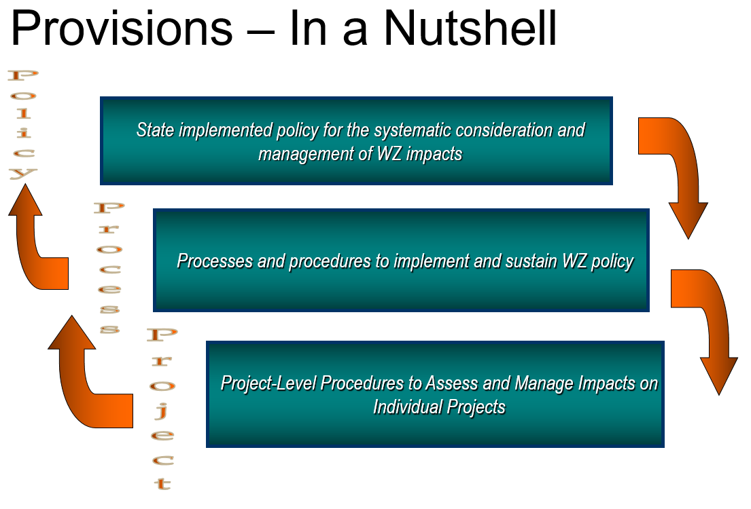
Overview of Subpart J

Slide 37
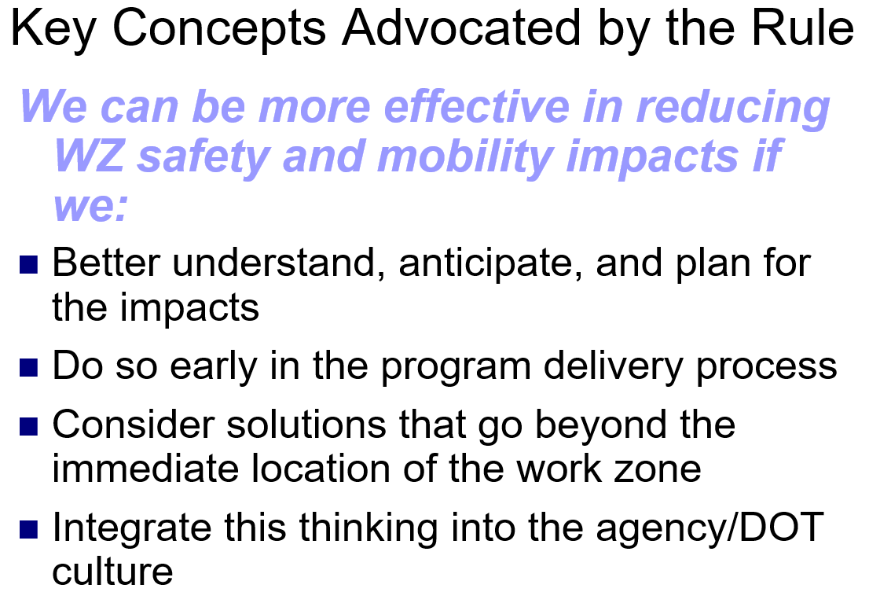
Overview of Subpart J

Slide 38
Overview of Subpart J
Agency WZ Safety and Mobility Policy
Agencies must develop and implement a policy for the systematic consideration and management of WZ impacts
Rule adds additional focus on mobility as well as safety impacts for work zones

Slide 39
Overview of Subpart J
Agency’s work zone policy:
May vary based on project characteristics and expected WZ impacts
Can be in the form of processes, procedures, and/or guidance

Slide 40
Overview of Subpart J
Use WZ safety and mobility info/data:
  To manage impacts on ongoing projects
  From multiple projects to improve processes and procedures
Require training for personnel involved in WZ planning, design, implementation, management, and enforcement
Conduct process review at least every 2 years to assess effectiveness of and improve state WZ procedures
Procedures for systematic WZ impacts assessment and management

Slide 41
Overview of Subpart J
Project-Level Procedures
Requires development and implementation of TMPs for all Federal Aid highway projects
Required content depends on significance
  Must always include a Temporary Traffic Control (TTC) Plan
  For significant projects, TMPs must also have:
    Traffic operations (TO) component
    Public information and outreach (PI) component

Slide 42
Overview of Subpart J
Significant Projects
Projects anticipated to cause sustained WZ impacts greater than what is considered tolerable based on State policy and/or engineering judgment
  Flexibility to tailor by State and within State
One project or combined effects of projects in one area
Briefly: Projects expected to cause a relatively high level of impacts

Slide 43
Overview of Subpart J
Significant Projects (cont.)
Automatically includes Interstate projects within a Transportation Management Area (TMA) that:
  Occupy a location for more than 3 days
  Have intermittent or continuous lane closures
  State may request an exception
Identify as early as possible

Slide 44
Overview of Subpart J
Agencies should coordinate with appropriate stakeholders in developing a TMP
Provisions for a TMP shall be in the project's Plans, Specifications, and Estimates (PS&Es)
DOT and contractor shall each designate a responsible person for implementing the TMP

Slide 45
Overview of Subpart J
PS&Es shall either contain:
  All the applicable elements of a DOT-developed TMP, or
  Provisions for a contractor to develop a TMP (e.g., for design-build jobs)
DOT must approve
  Contractor-developed TMPs
  Contractor-proposed TMP changes
Notes:
Projects expected to cause a relatively high level of impacts
Includes certain Interstate projects
Within the boundaries of a designated Transportation Management Area (TMA)
Occupy a location for more than 3 days
With intermittent or continuous lane closures
Flexibility to tailor by State and within State
One project or combined effects of projects in one area
Identify as early as possible
Other criteria established with State DOT Policy

Slide 46
Overview of Subpart J
Both the DOT and the contractor are required to designate a responsible person:
  At the project-level
  Who is appropriately trained
  Who has primary responsibility and sufficient authority for implementing the TMP and other safety and mobility aspects of the project
Notes:
Projects expected to cause a relatively high level of impacts
Includes certain Interstate projects
Within the boundaries of a designated Transportation Management Area (TMA)
Occupy a location for more than 3 days
With intermittent or continuous lane closures
Flexibility to tailor by State and within State
One project or combined effects of projects in one area
Identify as early as possible
Other criteria established with State DOT Policy

Slide 47
Module 3
TMP BASICS
Transportation Management Plans

Slide 48
What is a TMP?
Set of coordinated strategies implemented to manage WZ impacts of a project
Scale-able – projects with more expected impacts may need more analysis and more strategies
“TMPs would streamline the process through which road user impacts due to work zones can be properly analyzed and addressed.” - MD SHA
Notes:
Projects expected to cause a relatively high level of impacts
Includes certain Interstate projects
Within the boundaries of a designated Transportation Management Area (TMA)
Occupy a location for more than 3 days
With intermittent or continuous lane closures
Flexibility to tailor by State and within State
One project or combined effects of projects in one area
Identify as early as possible
Other criteria established with State DOT Policy

Slide 49
What is a TMP?
Design documents - how you are going to build a project
TMP - how you are going to manage transportation needs during a project
With today’s WZ challenges, a TTC plan may not be enough
TMPs = More comprehensive approach to managing WZ safety and mobility

Slide 50
TMPs are a Tool
Part of overall WZ management
Effective WZ management requires:
Understanding the likely impacts of a WZ
  Safety and mobility
Choosing a combination of strategies
  To address the impacts for that project
Implementing those strategies
The TMP outlines all that for a project

Slide 51
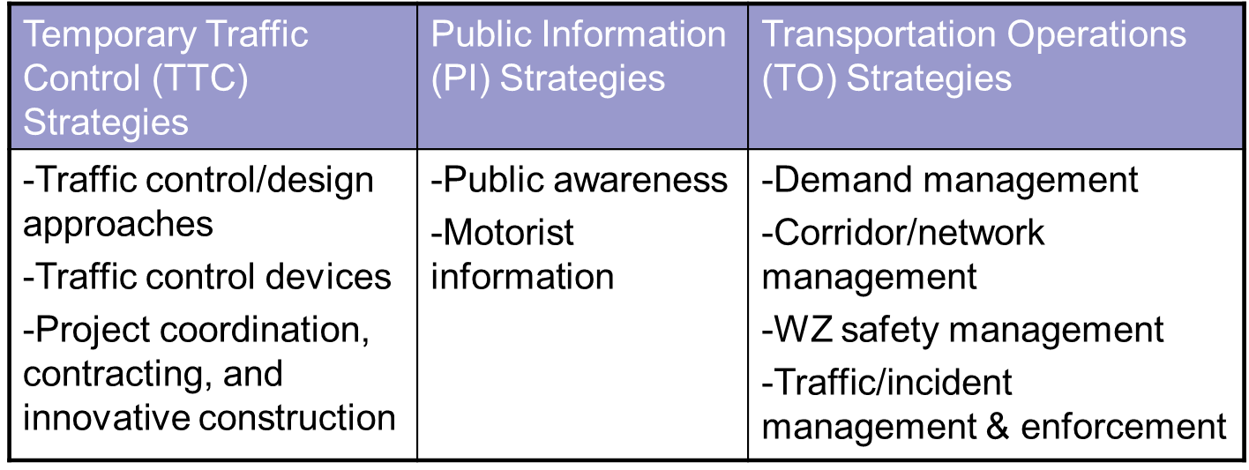
TMP Strategies to Manage Work Zone Impacts

Slide 52
Potential TMP Components
Introductory material
Executive Summary
TMP Roles and Responsibilities
Project Description
Existing and Future Conditions
Work Zone Impacts Assessment

Slide 53
Potential TMP Components (con’t)
Work Zone Traffic Management Strategies
  TTC Plan
  Traffic Operations Plan
  Public Information Campaign
TMP Monitoring Requirements
Contingency Plans
Implementation Costs
May be a single document, or several documents/plans complied together

Slide 54
Example: Wisconsin TMP Components
Type 1
  Traffic Control Plan
  Public Information and Outreach
Type 2, 3, 4
  Traffic Control Plan
  Public Information and Outreach
  Transportation Operations
  Incident Management

Slide 55
Example: Michigan TMP Template
Table of Contents:
Executive Summary
Temporary Traffic Control Plan (TTCP)
Transportation Operations Plan (TOP)
Public Information Plan (PIP)
Delay Calculation Details
Alternative Traffic Control
Vicinity Map or Location Diagram

Slide 56
Michigan TMP Executive Summary
Basic description - Location, work type
Specific Project Data:
  Letting Date
  Anticipated Project Duration (Construction Start Date and Completion Date)
  Existing Lane Widths
  Existing Paved Shoulder Widths
  Existing Aggregate Shoulder Widths
  Threshold Criteria
    Which criteria were exceeded ?
    How was delay calculated?
    What is the source of traffic volumes?
  Facility Details (e.g., ADT, lanes)
  Crash Analysis and Safety Review

Slide 57
TMP Formats
TMPs need to be documented
Options include:
  Single document with all included material
  Brief document with summaries of analysis results and decisions, where the full documentation is in the project files or similar
  PowerPoint format has been used
  Others?
Scope, content, level of detail may vary based on DOT policy and impacts

Slide 58
Importance of a TMP
What are the benefits of having a well thought-out approach to managing traffic during a construction project?
Consider your stakeholders:
  Contractors
  Motorists
  Property owners
  Project owners
  Businesses
  Environment
  Event organizers, etc.

Slide 59
Why TMPs? –Key Benefits
A well-planned method for managing traffic flow during construction can:
Promote efficient and effective construction phasing and staging, minimize contract duration, and control costs
Improve safety for workers and road users
Minimize traffic and mobility impacts
Address impacts at corridor and network levels

Slide 60
Why TMPs? –Key Benefits (cont.)
A well-planned method for managing traffic flow during construction can:
Minimize:
  Circulation, access, and mobility impacts to local communities and businesses
  Complaints from road users, businesses, and communities
Improve:
  Intra- and inter-agency coordination
  Improve public awareness

Slide 61
Why TMPs? –Key Benefits (cont.)
Better documentation of analysis and mitigation of impacts
Better coordination and scheduling of projects
More basis for reviewing MOT changes requested by the contractor

Slide 62
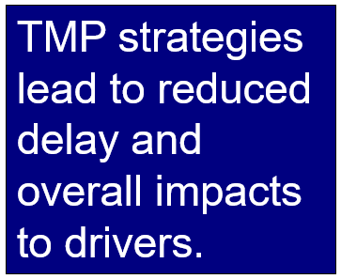
TMPs Lead to Satisfied Drivers
Rhode Island - number of customer complaints about roadwork has decreased
Michigan - customers have been calling with positive comments about work zones

Slide 63
TMP Development Process
Compile Project Material
Determine TMP Needs
Identify Stakeholders
Develop TMP
Update/Revise TMP
Finalize Construction Phasing/Staging and TMP

Slide 64
TMP Development Process (continued)
Re-evaluate/Revise TMP
Implement TMP
TMP Monitoring
Update/Revise TMP Based on Monitoring
Post-Project TMP Evaluation

Slide 65
TMP Team Approach
Better coordination throughout the process from development to implementation
Involve all involved offices internally
  TMP Coordinator
  Planning
  Design
  Traffic engineering
  Construction
  Operations (maintenance)?

Slide 66
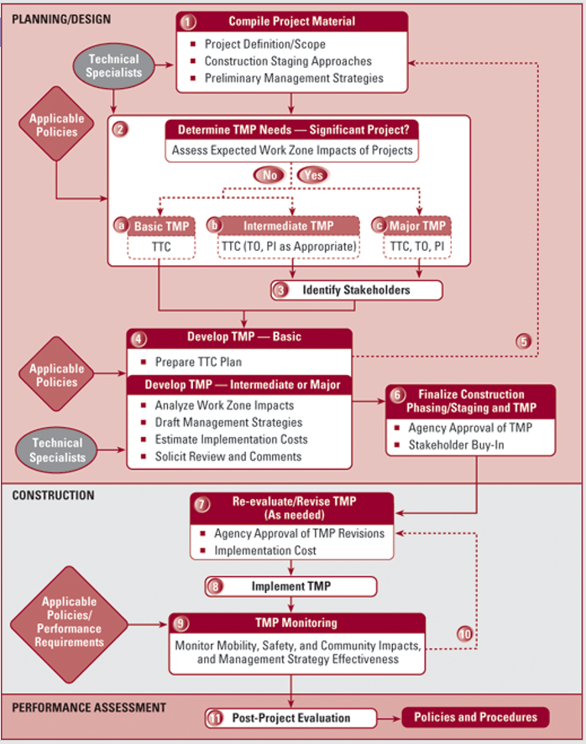
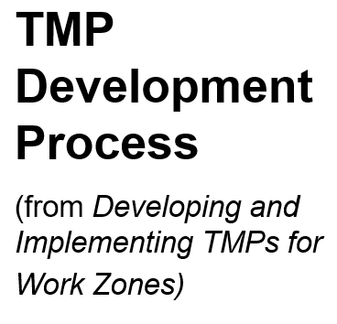

Slide 67
When is a TMP Developed?
TMP development should begin early and progress throughout
Systems planning and preliminary engineering
  Include TMP development and implementation costs in project budget
Design
  Consider WZ impacts in evaluation and selection of design alternatives
  May be possible to choose a design alternative that alleviates many WZ impacts
  Complete TMP development

Slide 68

During Design…
Final assessment of WZ impacts is done, which should affect the choice of:
  Best construction/staging option(s)
  Most suitable design and contracting approach
  Most appropriate WZ traffic management strategies

Slide 69
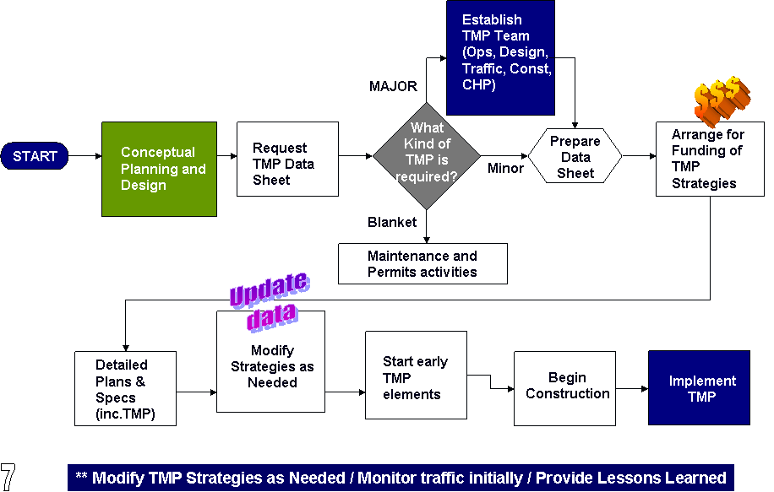
Caltrans TMP Development Process

Slide 70
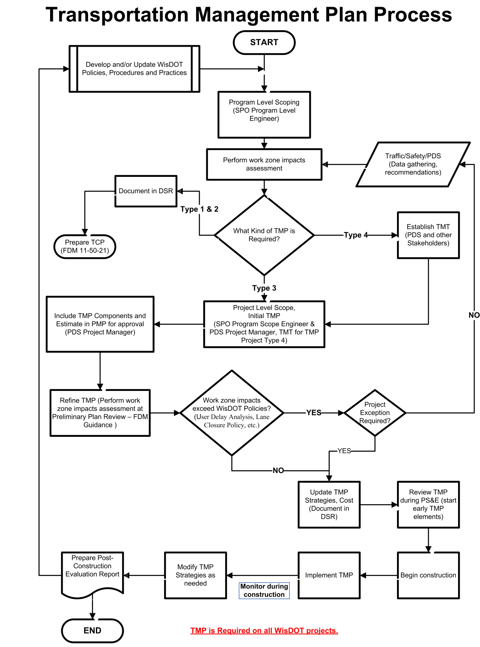
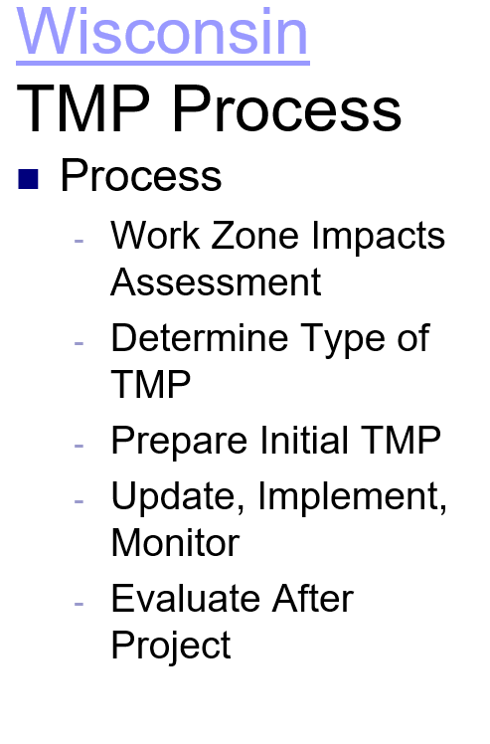

Slide 71
TMPs Need to Be…
Well-thought out
Started early in project development
Use a multi-disciplinary approach
Coordinated with other projects nearby
Contain a combination of strategies
Fit the expected level of WZ impacts
Funded
Updated as needed after project award
Implemented!
Monitored – and adjusted as needed

Slide 72
Key TMP Development Questions
Was a TMP developed for the project?
Does the TMP consider the expected impacts of the project?
Did the agency determine if this is a significant project?
Does the TMP contain strategies to manage the identified impacts?
Are the strategies reasonable for the level of expected impacts?

Slide 73
Key TMP Development Questions (cont.)
Were key stakeholders involved?
Is implementation of the TMP funded?
Has a responsible person been designated for the DOT?
Has the DOT approved the TMP per its policies/procedures?
Are the relevant parts included in the bid package?

Slide 74
Module 4
WZ Impact Assessment and Mitigation

Slide 75
Work Zone Impact Assessment
WZ Impact Assessment is the process of understanding the safety and mobility impacts of a road construction or maintenance project

Slide 76
Work Zone Impact Assessment
Determine impacts of project?
  Acceptable? If yes, no problem
  Unacceptable? (Significant project)
    Can strategy be found to mitigate impacts to acceptable level?
      Yes – develop TMP
      No – determine best strategy
      Advise stakeholders of possible problems

Slide 77
Work Zone Impact Assessment
WZ Impacts Considerations:
Maximizing Safety
  Road Users
  Workers
Maximizing mobility and accessibility
  Road user costs
  Emergency services
  Businesses
Constructability
  Building projects effectively and efficiently

Slide 78
Work Zone Impact Assessment
Benefits of Assessing Impacts
Identify and understand all impacts of the project
Identify “significant projects” and determine suitable TMP
Aid in identifying and evaluating alternative strategies
Monitor and manage WZ impacts during construction

Slide 79
Work Zone Impact Assessment
Mobility Issues
  Delay
    Reduced quality of life issues
    Significant Projects – agency definition
    Reduced Speeds
    Queues and complete stoppages
  Freight Interference
    Travel time reliability – biggest concern
    Delayed deliveries
    Unanticipated costs
  Emergency response

Slide 80
Work Zone Impact Assessment
Safety Impacts:
Road user exposure to hazards
  Will staging create safety hazards greater than existing?
Worker exposure to traffic
  Staging allow for positive protection?
Geometrics during phases
Availability of law enforcement
Speed reduction necessary/considered?

Slide 81
Work Zone Impact Assessment
Business Impacts:
Access
  Temporary entrances
    Signing and pavement
  Advance notification of phase changes
    Keep owners informed
Work Schedules
  Holiday shopping season
  Weekends and special events

Slide 82
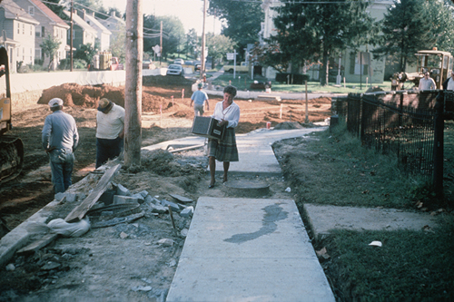
Work Zone Impact Assessment
Pedestrian Impacts
MUTCD Part 6D:
  If project affects the movement of pedestrians, adequate pedestrian access and walkways shall be provided.

Slide 83
Work Zone Impact Assessment
Impact Assessment:
Proactive versus reactive
Use early in the TMP Development process to identify and estimate the magnitude of the impacts
Assess impacts on regional basis
Use assessment to help evaluate various strategies for mitigating impacts
Possibly use assessments to justify TCP revisions after award of project

Slide 84
Work Zone Impact Assessment
Impact Assessment (continued):
Agency WZ policies
  E.g., Maximum WZ queue lengths/delays allowed
Lane Closure policies/charts that specify when a lane closure is permitted
Analytical/modeling tools used by the agency
Concerns of stakeholders

Slide 85
Work Zone Impact Assessment
GOAL:
A good impact assessment process should keep agency from being surprised after project is underway – when it is too late to consider strategies to reduce impacts.

Slide 86
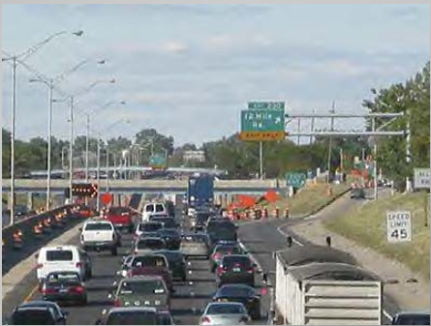
Mitigating Work Zone Impacts
Manage Demand (major projects)
Maintain and/or augment capacity

Slide 87
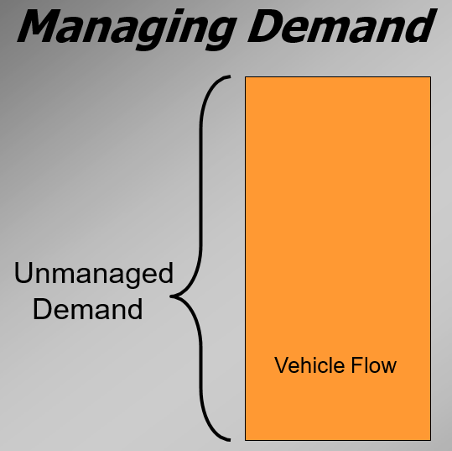
Mitigating Work Zone Impacts

Slide 88
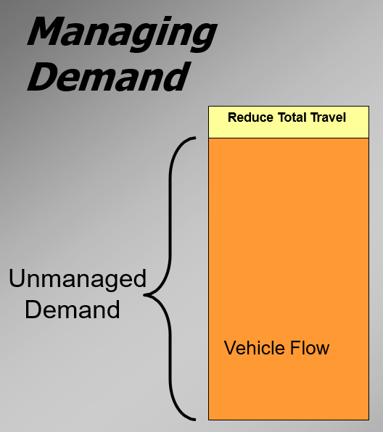
Mitigating Work Zone Impacts
Discourage discretionary travel
Non-traditional work schedules (4-day weeks, shift starting times)
Telecommuting
Cooperation/Support of major employers a must

Slide 89
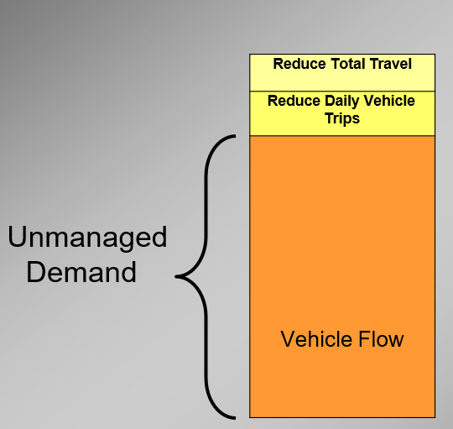
Mitigating Work Zone Impacts
Enhanced transit service
  Increased service
  Express service
  Van/car pooling
  Park ‘n rides
Encourage public efficiency

Slide 90
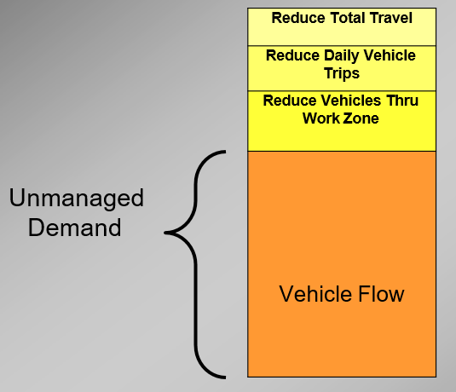
Mitigating Work Zone Impacts
Alternative Routes
urge public to avoid work zone
signed alternate routes
mandatory alternate truck route

Slide 91
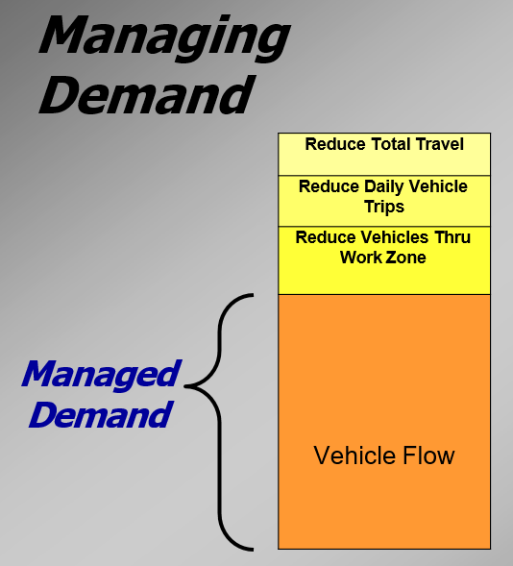
Mitigating Work Zone Impacts

Slide 92
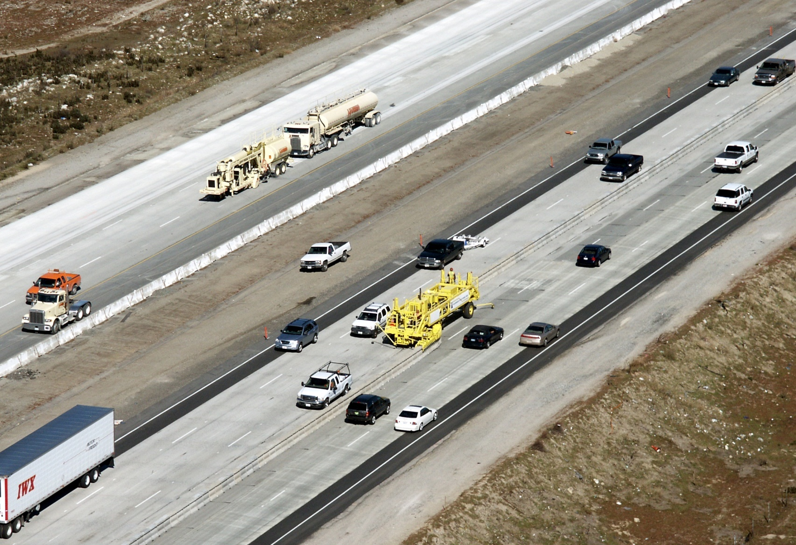
Mitigating Work Zone Impacts
Maintain or Augment Capacity:
Utilize / Widen shoulder
Diversions and Detours
Reversible Lanes during peak hour
Parallel Route
Mass Transit

Slide 93
Detours / Diversions
Detours utilize existing roadways and should be of the same quality as the existing roadway or the proposed roadway.
Detours must be evaluated for safety and structural capacity for the traffic volumes and types that will be using them.
Diversions utilize temporary roadways designed considering traffic volumes, speeds, and the duration of use.

Slide 94
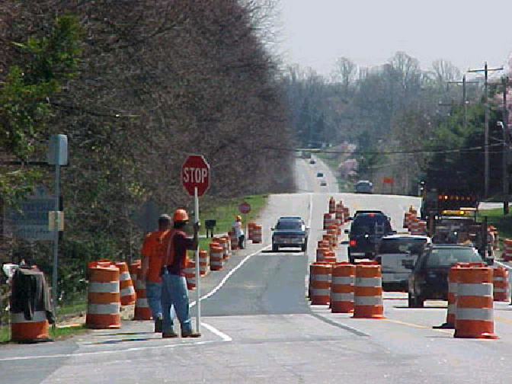
Potential TMP Strategies
Full Road Closure
Weekend Full Closure
Limited Capacity Closure
Night time / Off-peak Closure
Intermittent Closure

Slide 95
Advantages of Full Closure
Impact on customers (travelers) is for a shorter
duration than traditional part width-construction
Use of detour was deemed a safer driving environment
Safer working environment for the highway worker
Received a higher quality end product

Slide 96
Disadvantages of Full Closure
Limited locations it can be used
More coordination and planning needed up front
Potentially more significant economic impacts
More expensive ?

Slide 97
Contracting Strategies
Incentives
Disincentives
Bidding Alternatives
  A + B (Cost plus Time)
  Lane Rental
Design Build

Slide 98
Traffic Operations Plan
  Incident management plan for work zone
    Pre-stationed tow operators during peak hours
  Motorist Assist Patrols
    Utilize existing with added units
    Contract during project
  Demand reduction strategies
    Carpools
    Increase transit ridership
  ITS real time traffic information systems

Slide 99
Incident Management Plan
Ensure access to all areas for emergency vehicles
  Hospitals nearby?
  Trauma centers?
Plan to provide access within work site
  Identify alternate routes
  Pre-sign for use during incidents?
Pre-station tow operators during peak hours

Slide 100
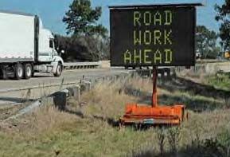

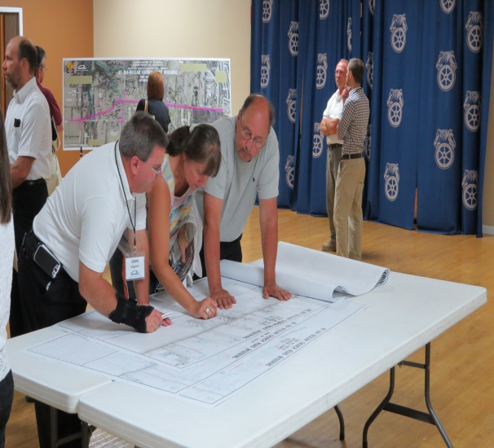
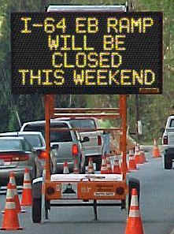
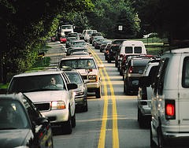
Module 5: Public Information Plans

Slide 101
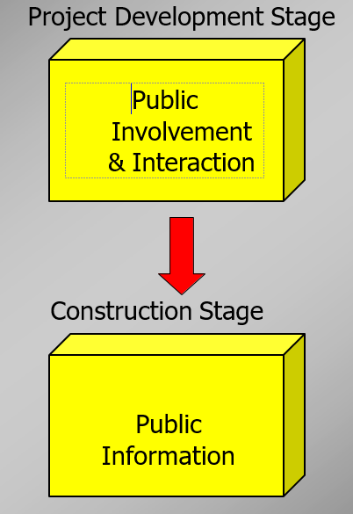
Public Involvement versus Public Information

Slide 102
Public Information and Outreach Plans
A work zone public information and outreach campaign typically involves several strategies to communicate with:
Road users
Pedestrians & bicyclists
General public
Area residences and businesses
Other appropriate public entities

Slide 103
Public Information and Outreach Plans
Why Develop and Implement a Public Information and Outreach Campaign?
Increases traffic safety
Increases mobility / decreases congestion
Limits traveler dissatisfaction
Develops a partnership with the community
Improves public perception

Slide 104
Public Information and Outreach Plans
Public needs:
to feel involved
to know we care
to feel ownership
to feel their concerns are addressed
to know their well-being & safety are a priority
to be informed – no surprises

Slide 105
Public Information and Outreach Plans
An Effective Plan will:
Identify target audiences for the campaign.
Develop the message for the campaign.
Determine the appropriate size and nature of the public information and outreach campaign.
Determine communication strategies disseminating the messages to the target audiences.

Slide 106
Public Information and Outreach Plans
An Effective Plan will:
Identify resources necessary to support the campaign.
Identify partners to assist in developing and implementing the campaign.
Determine communication timing for the campaign.
Evaluate the effectiveness of the campaign.

Slide 107
Public Information and Outreach Plans
Identify Your Target Audience
Who cares?
Who cares the most?
Who should care?
How do you reach them?
How do you best “communicate” with them?

Slide 108
Public Information and Outreach Plans
Successful work zone public information and outreach campaigns generally incorporate three messages:
Safety first
Plan ahead to minimize delay
We care

Slide 109
Public Information and Outreach Plans
Safety First
Protecting themselves and highway workers
Rules / guidelines of work zones (posted speed limits, stay alert, lane changes, slowing traffic, etc.)
Warnings about increased traffic fines and enforcement.

Slide 110
Public Information and Outreach Plans
Plan Ahead to Minimize Delay and Frustration:
Convey travel times or delays
Alternate routes
Different modes of travel available
Encourage flex time
Give work zone details

Slide 111
Public Information and Outreach Plans
We Care:
All necessary steps have been taken to make things easier.
Considered their needs, listened.
Benefits of the project to them.
We’ve gone above and beyond.
Keep them informed (type of work, duration, benefits, periodic updates).
Do what we say

Slide 112
Public Information Strategies
Project website\APPS\Social Media
Email\Twitter alerts
Web-connected traffic cameras
Direct mail (community contact letter, other materials)
Brochures/flyers/fact sheets
Newsletter
Public meetings/workshops/events
Project model display with related information
Newspapers advertising and articles
TV advertising, articles, traffic spots
Radio advertising, articles, and traffic spots
Google Maps
Employee newsletters
Video
CB radio network (for truckers)
Information center or kiosk
Billboards
Project hotline
• 511
Changeable Message Signs
Personal contacts
Press kit
Business survival kit
Branding

Slide 113
Public Information Strategies
Determine communication timing for the campaign:
When to begin messages prior to the project beginning
Messages prior to phasing change
Frequency of the message
Updating Information
Project Completion

Slide 114
Public Information Strategies
Messaging:
Keep the message consistent
Keep the message simple
Identify who is responsible to give the message
Be aware of sign fatigue and stale messages

Slide 115
Public Information and Outreach Plans
Evaluate and Improve:
Feedback from the public
Did we reach our intended target?
Was our message clear and was it accepted?
Improvements to communication
Signing inspection and evaluation
What could be improved on this project or the next project?

Slide 116
Module 6
TMP
Monitoring and Evaluation

Slide 117
Objectives During Construction
Resolve any pre-construction coordination issues
Assess impact of any proposed MOT changes prior to start of work
Update TMP (if needed)
Implement the TMP
Actively monitor and manage WZ impacts during construction
Revise TMP and implement appropriate revisions, as needed
Document any findings, lessons for use in performance assessments

Slide 118
During Construction
Install TMP components (TTC, TO, and PI)
Inspection of TTC component
Observation/Measurement of TO component
Communication with public (PI component)
  Construction staff may have lead in coordination and implementation of PI strategies
Consult with stakeholders to:
  Keep stakeholders informed
  Seek input on and knowledge of regional issues
  Improve inter-agency and intra-agency coordination and response to WZ issues

Slide 119
Implement TMP
The TCP is implemented – usually by a contractor.
In some cases, components of the TMP may need to be implemented prior to construction (e.g., public relations campaign, improvements to detour routes, etc.).

Slide 120
TCP Implementation Issues
Temporary Concrete Barrier (TCB)
Delineation (incl. Pavement Markings)
Clearances
Excavation & Drop-Offs
Barrier End Treatments

Slide 121
TCP Implementation Issues (continued)
Ramps (Entrance & Exit)
Speed Limit Enforcement
Nighttime Work
Worker Protective Equipment
Pedestrian pathways established
  ADA compliant

Slide 122
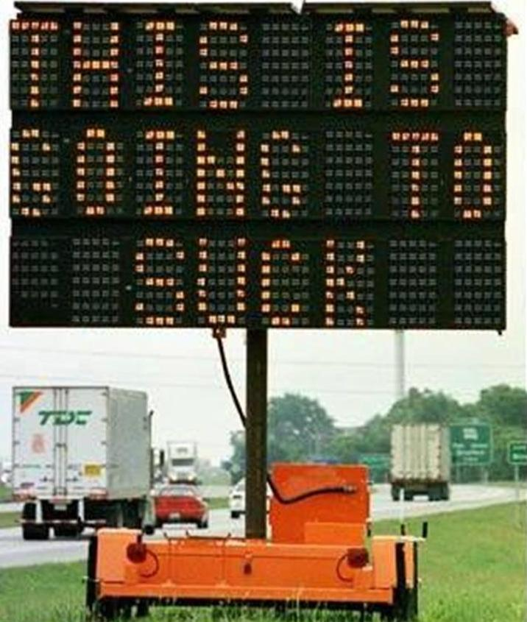
TCP Implementation Issues (continued)
PCMS –
Appropriate Messages
Reflect current conditions
Static Signing –
  Visible
  Breakaway supports

Slide 123
Installation of Devices
Follow plan sheet layouts
  Proper types of devices
  Devices meet specifications
    Reflective sheeting on signs and channelizing devices
    Quality of devices
  Lighting (night work)
    Adequate for workers
    Glare for road users

Slide 124
Setup Inspection
Should be done initially and after each phase change
Does plan address site conditions?
  Adequate sight distance
    Adjust location of devices
    Additional measures needed
  Access provided to residences and businesses
  Roadside appurtenances
    Protected
    Existing Condition

Slide 125
Initial Setup
Drive through
  Positive guidance provided for unfamiliar user
  Hazards properly delineated
  Appropriate sign messages
  CMS messages reflect current conditions
  Others?

Slide 126
Maintenance of Devices
Routine (Daily) Inspections
  During working hours
  After work has stopped
    Last duty of inspector before leaving the project site – drive through and be sure devices are in proper location
    Devices often moved for contractor access during working hours

Slide 127
Traffic Operation Implementation
Alternate routes
  Strategies to encourage use working?
  Operational issues on alternate routes?
Emergency vehicle access to work area or through project
Work Zone ITS
Speed Control Measures
Coordination with other projects in corridor
Queuing

Slide 128
Traffic Operation Implementation
Work zone ITS
  Systems installed properly and calibrated to provide accurate information?
  PCMS messages legible and accurate?
  Dynamic Merge System applied properly?
  Loss of credibility of device

Slide 129
Speed Control Measures
Signing
  Proper placement/maintenance of reduce speed zone signs
  Existing (conflicting) speed limit signs covered or removed
Law Enforcement Officers
  Involve in planning or preconstruction
  Communicate what they are to do
    Active enforcement
    Presence

Slide 130
Speed Control Measures
Signing
  Proper placement/maintenance of reduce speed zone signs
  Existing (conflicting) speed limit signs covered or removed
Law Enforcement Officers
  Involve in planning or preconstruction
  Communicate what they are to do
    Active enforcement
    Presence

Slide 131
Public Information Implementation
Coordination with local media
  News releases
  Interviews with project personnel
Printed materials distributed
Web site updated
  Travel times/delays (if applicable) accurate
Feedback from public

Slide 132
The TMP is implemented. Now what?
Our work is not done
All the effort culminates in one thing:
  How does the TMP work in the field?
    Are conditions as expected?
    Do major issues arise?
    Are there many complaints or “bad press”?

Slide 133
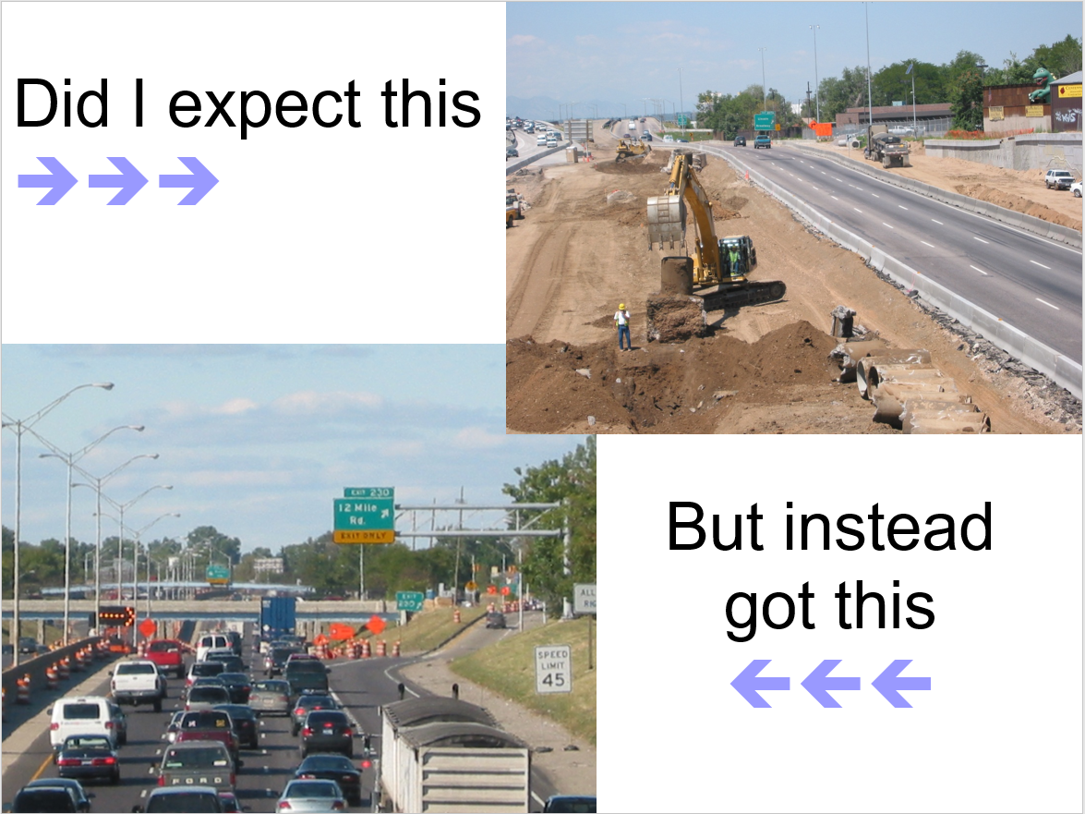

Slide 134
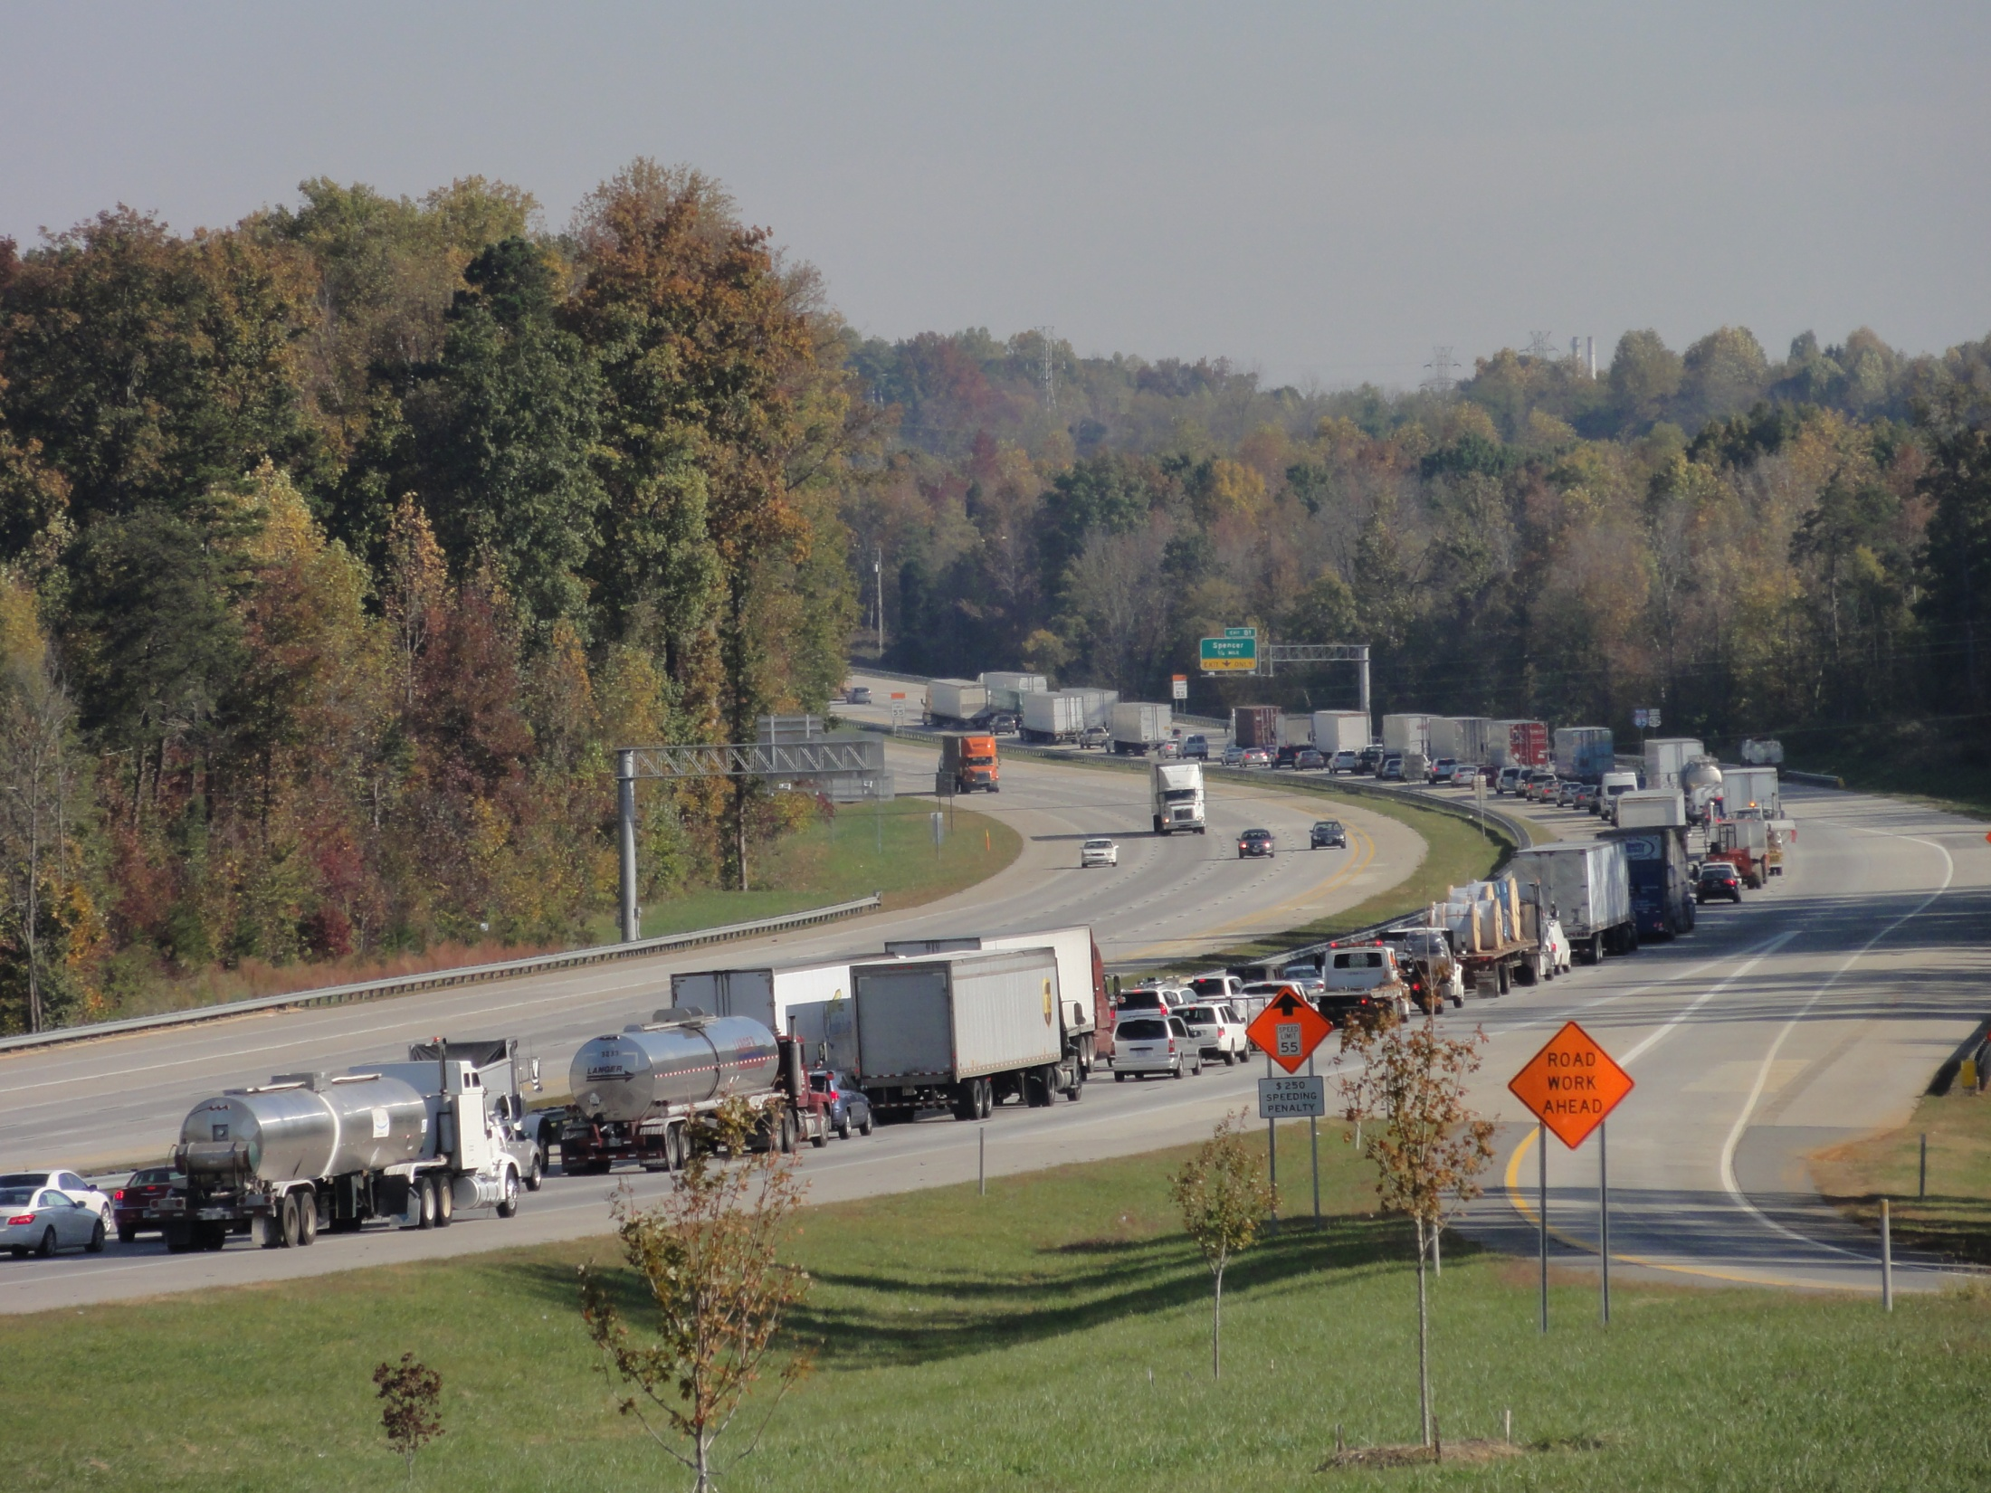
How Did This Happen To My Project???

Slide 135
How is the TMP working?
Great. No changes are needed.
Poorly.
  What went wrong?
  Can we fix it?
  If not, what can we do?
Ok. Some tweaks might be needed.
What can we learn?

Slide 136
Monitoring TMPs During Construction
Monitoring WZ and TMP performance during construction are important to see if:
  Field conditions are similar to predicted impacts used in planning and design
  TMP strategies are effective in managing impacts
If performance requirements are not met, what can be changed to improve performance?
  DOT and/or contractor should revisit the TMP and consider alternate strategies and/or approach(es)
  TMP changes must be approved by the DOT

Slide 137
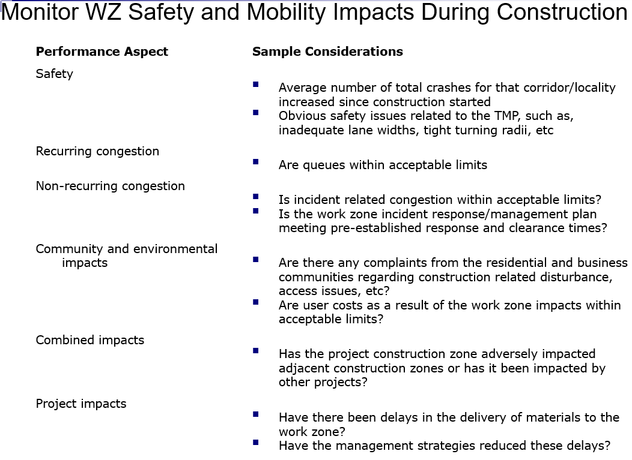

Slide 138
What to Expect
Variety of strategies - simple to complex
  Documenting observations from REs
  Sampling
    Travel time runs, queue monitoring, surveys
  Collecting police/crash reports
  Deploying mobile trailers with sensors
  Using ITS (existing or new)
  Using TMCs
  Buying data from a 3rd party vendor

Slide 139
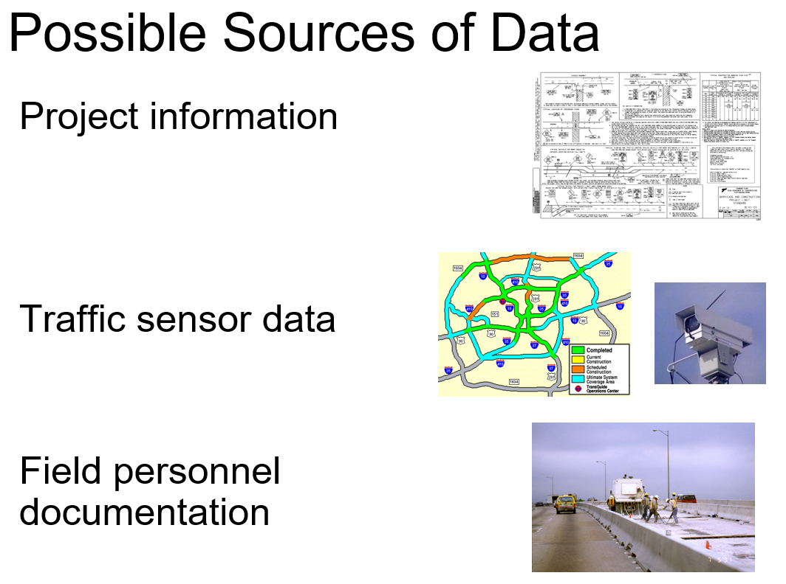

Slide 140
Example TMP Monitoring Policies
Construction staff
  Monitor and collect WZ crash data
  Identify problematic trends
  Implement appropriate adjustments
Monitor queue length for all significant projects
  At beginning, middle, and end of each shift for the first week of every phase change (or during daily TCC inspection)
  Compare to plans
Project manger submit a quarterly report on:
  TO summary
  Incident summary
  Public comments
  Personal observations

Slide 141
Project-Level Performance
Example Measures:
  WZ Safety Performance
    Traffic crash statistics
    Worker fatalities and injuries
    Speed/speed variance
  WZ Mobility Performance
    Delay
    Speed
    Travel time
    Queue length
  Exposure

Slide 142
Project-Level Performance (cont.)
Example Measures:
  Construction Efficiency and Effectiveness
    On-time completion
    Cost-efficiency/effectiveness
    Quality of work
  Efforts made to address impacts
  Public Perception
    Calls/comments received – pro and con
    Customer satisfaction indexes
    User perceptions about the safety and mobility of the work zone

Slide 143
Changes to a TMP Can...
Affect the MOT decisions made by the DOT during project development
Increase work zone impacts
  Queues & delays
  Potential for crashes
Reduce the effectiveness of the TMP

Slide 144
If changes are proposed...
How will revised impacts be assessed?
Who will update the impacts assessment?
Are any increased impacts acceptable?
What are the critical issues to address in the TMP? e.g.,
  Alternate route availability
  Effects on businesses and residents
  Changes to lane closures
Who will update the TMP, as needed?
Who will pay for these activities?
Who will pay for any changes in cost to TMP implementation?

Slide 145
Responsible Persons
Both DOT and the contractor must designate a responsible person:
  At the project-level
  Who is appropriately trained
  Who has primary responsibility and sufficient authority for implementing the TMP and other safety and mobility aspects of the project
They need to review TMP changes

Slide 146
Objectives Post-Construction
Finish documentation of project results and lessons learned
Review findings
Consider findings in light of findings from other projects
Identify improvements to TMP process and/or modify guidelines/specs for future projects

Slide 147
Document Performance Findings
Summary of the following information:
  Observed and/or measured impacts
  Compare actual impacts versus the impacts
  Effectiveness of TMP and management strategies
  Best practices
  Innovative approaches/techniques/technologies used
  Lessons learned
  Recommendations for policy or procedural change

Slide 148
Example Post Construction Conditions/Policies
Report required for each significant project (and others as appropriate) identifying TMP successes and failures
General rating of TMP by field personnel
  Revisions required
  Comparison of actual conditions to predicted
  Cost to implement

Slide 149
Program-Level Assessment
Looking at multiple projects together
Combination of existing/available data sources
  Results of impacts assessment and any travel planning and forecasting models
  Field observations
  Crash records
  TMP and TMP evaluation findings
  Interviews
  Surveys

Slide 150
Why Assess TMP Performance?
Opportunity to learn
Know how TMPs are working and what to improve
Identify and share best practices
Support decision making

Slide 151
Module 7
TMP
Resources and Wrap-up

Slide 152
TMP Resources
WZ Safety and Mobility Rule Web Site
  Example TMPs, development resources
Developing and Implementing TMPs for Work Zones
  Includes a TMP Checklist and matrix of strategies
Templates and Samples
Online Training
FHWA
http://www.ops.fhwa.dot.gov/wz/resources/final_rule.htm
https://www.workzonesafety.org/topics-of-interest/transportation-management-plans/

Slide 153
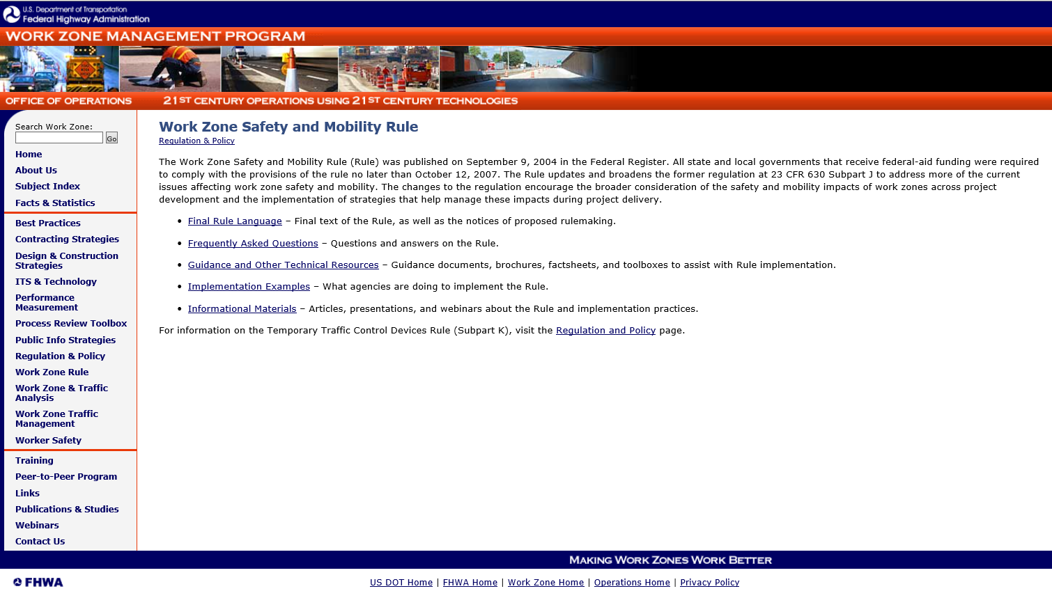
http://www.ops.fhwa.dot.gov/wz/resources/final_rule.htm

Slide 154

http://www.ops.fhwa.dot.gov/wz/resources/final_rule.htm

Slide 155
YOUR TURN…

Slide 156
THANK YOU!

